Slide 1
UNSW Heroes T3 2020
Team 11 - UNSW Advantage
Akshita Bhat | Nihitha Sudarsan Sampath | Luqi Huang | Karan Inder Singh
Mentor: Fengyang Li

Slide 2
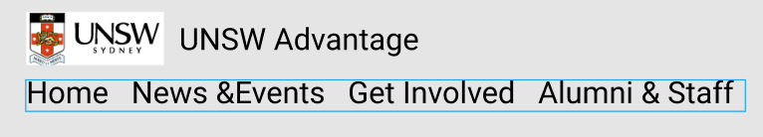
Problem Statement
To re-work on the current UNSW Advantage website and ensure the following necessities are established (student.unsw.edu.au/advantage/welcome):
Student and opportunity centric
Jargon-free
Easy maintenance along with consistent updates (i.e. add, remove, update recognized activities easily)
Showcase ‘best practice’ AHEGS recognized activities on campus (e.g. ASPIRE, Hero Program, Founders, ARC Executive initiative)

Slide 3
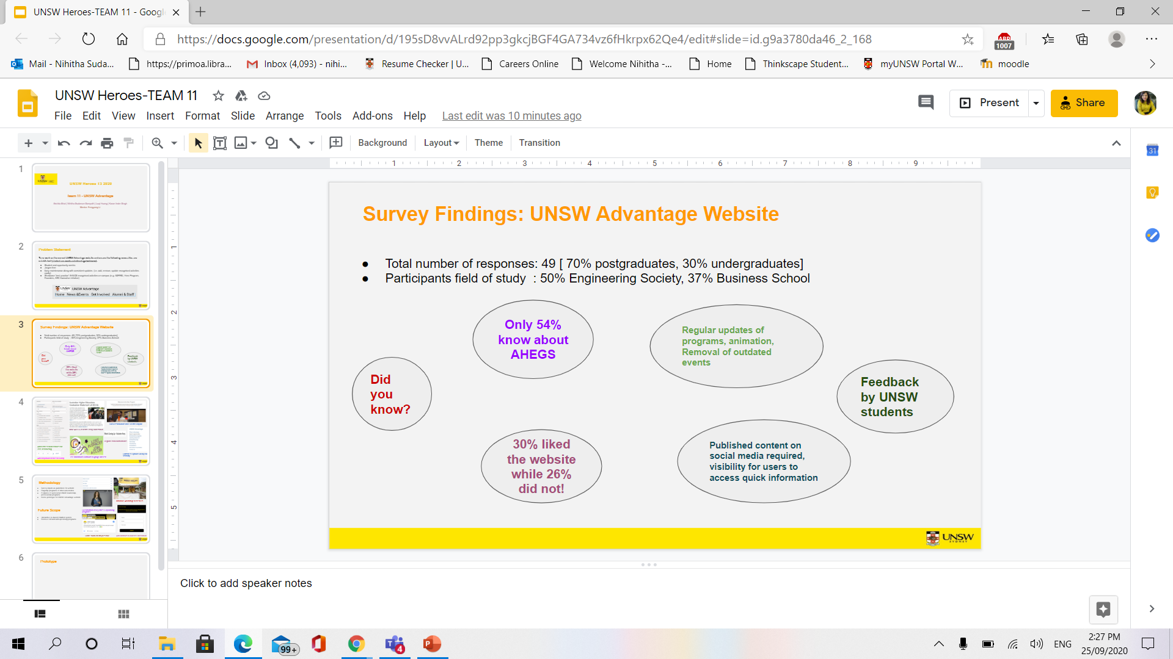
Survey Findings: UNSW Advantage Website
Total number of responses: 49 [ 70% postgraduates, 30% undergraduates]
Participants field of study : 50% Engineering Society, 37% Business School

Slide 4
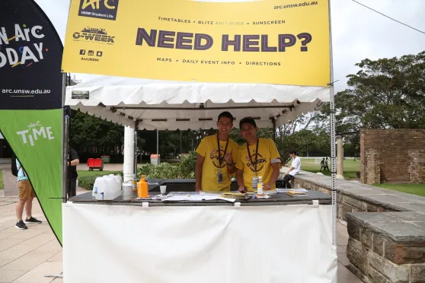
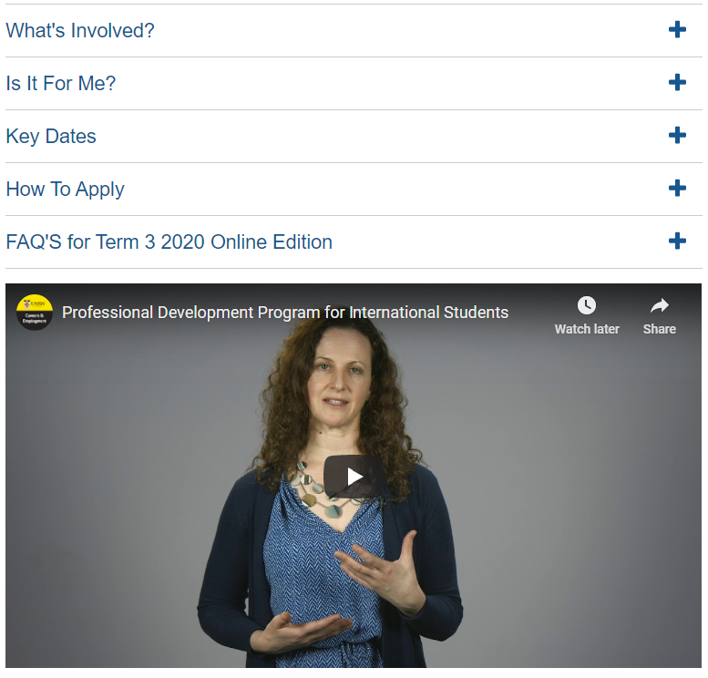
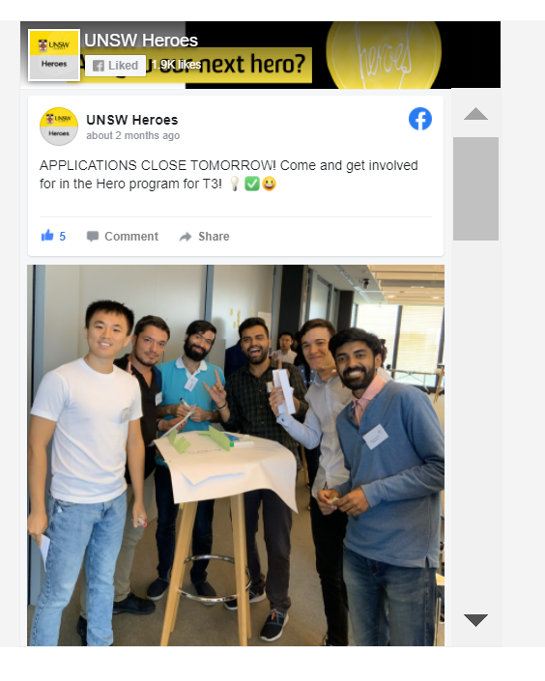
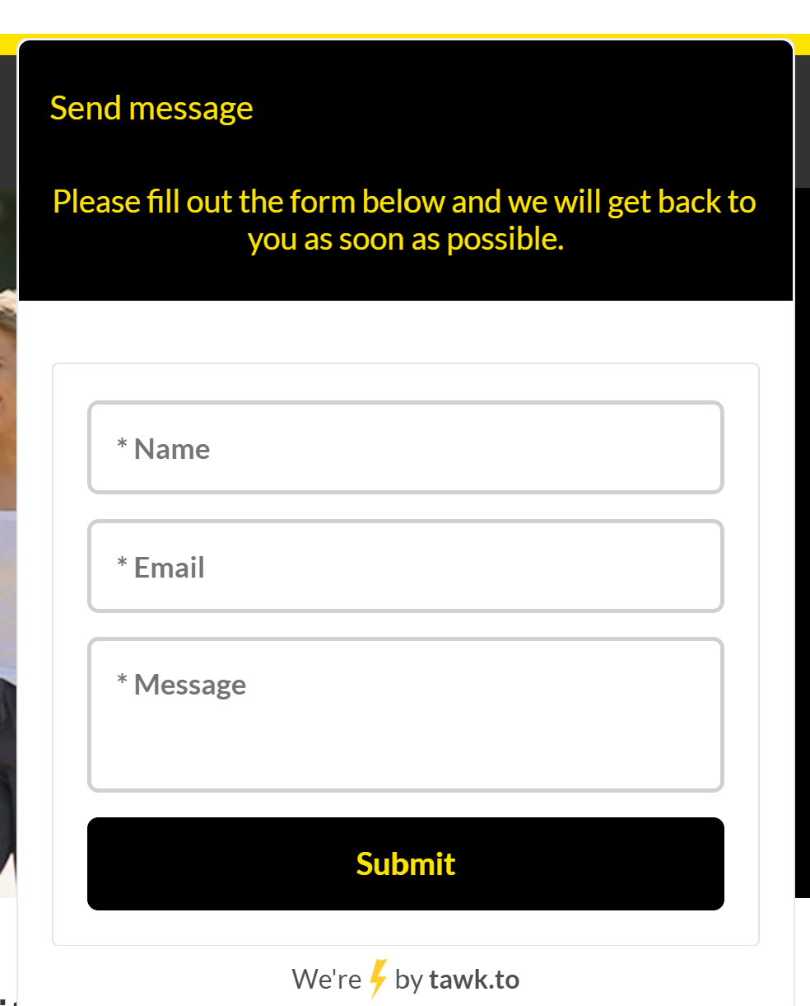
Methodology
Survey inputs as guidelines for website
Flagship programs of other universities
Features of successful UNSW leadership , professional programs
Demo prototype for UNSW Advantage website
Future Scope
Introduce Advantage to freshers
Interactive AI-based chatbot system
Remove old and add upcoming programs
Specification of key dates & upcoming programs
Share social-media presence
Add chatbots to increase interaction

Slide 5
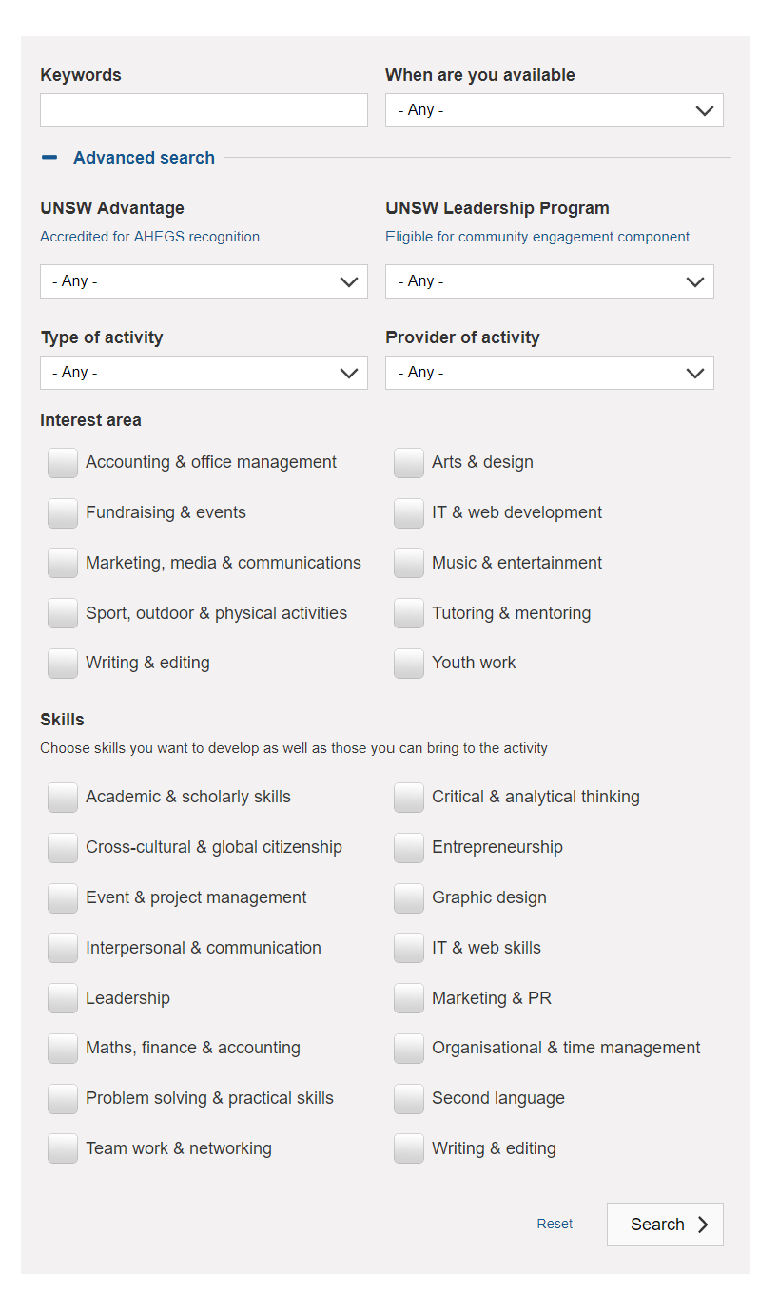

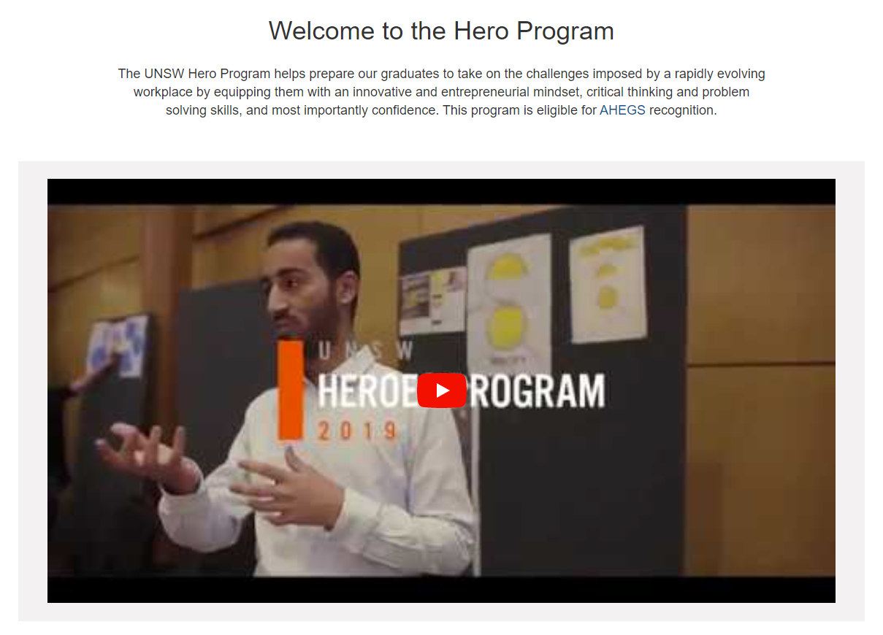
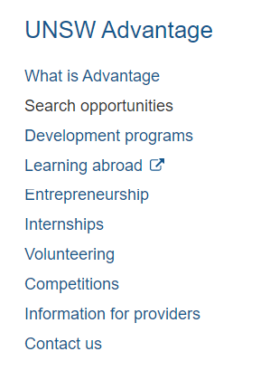
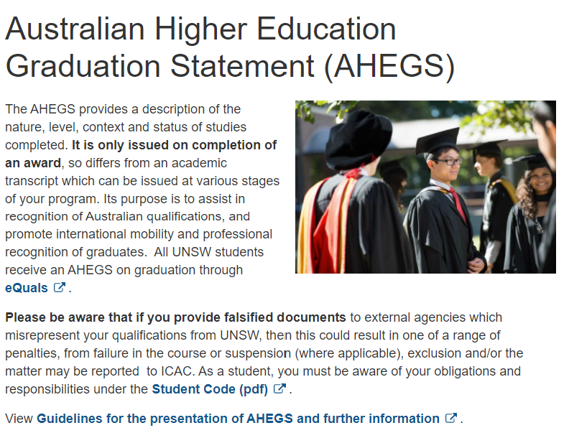
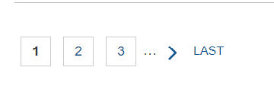

Use animations/ cartoons to gauge interest
Video testimonials have a better impact
Add better search features for ease of browsing
Add dropdown menus for clarity
Regular email notifications
Shift these options on top for visibility
Make AHEGS benefits easily understood

Slide 6
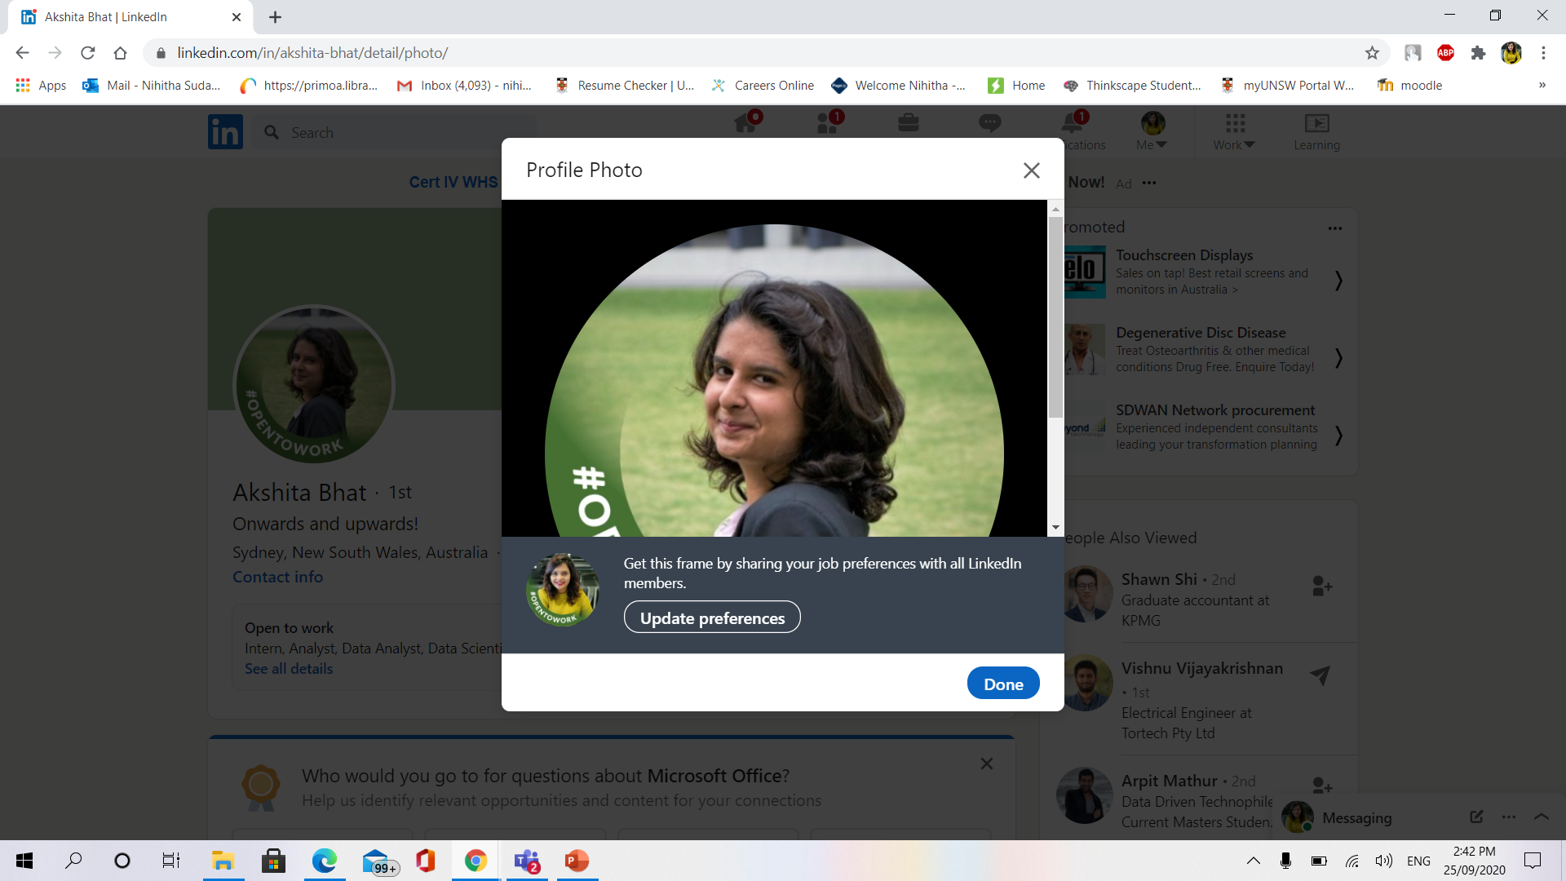
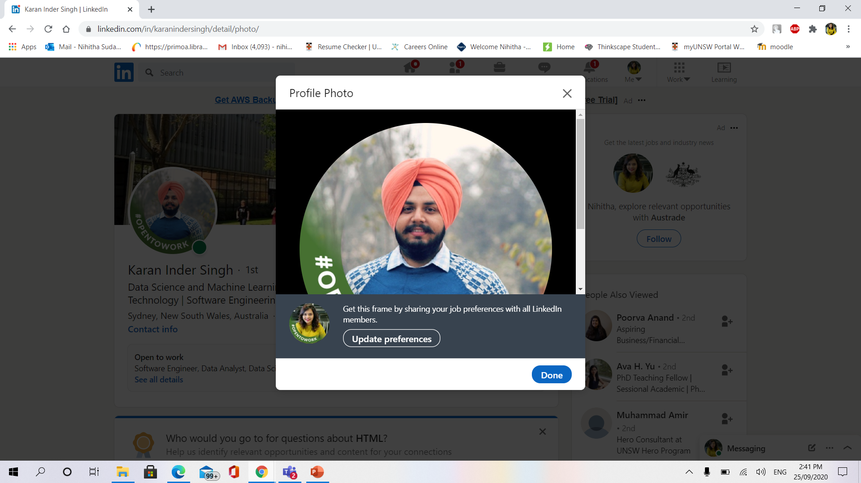
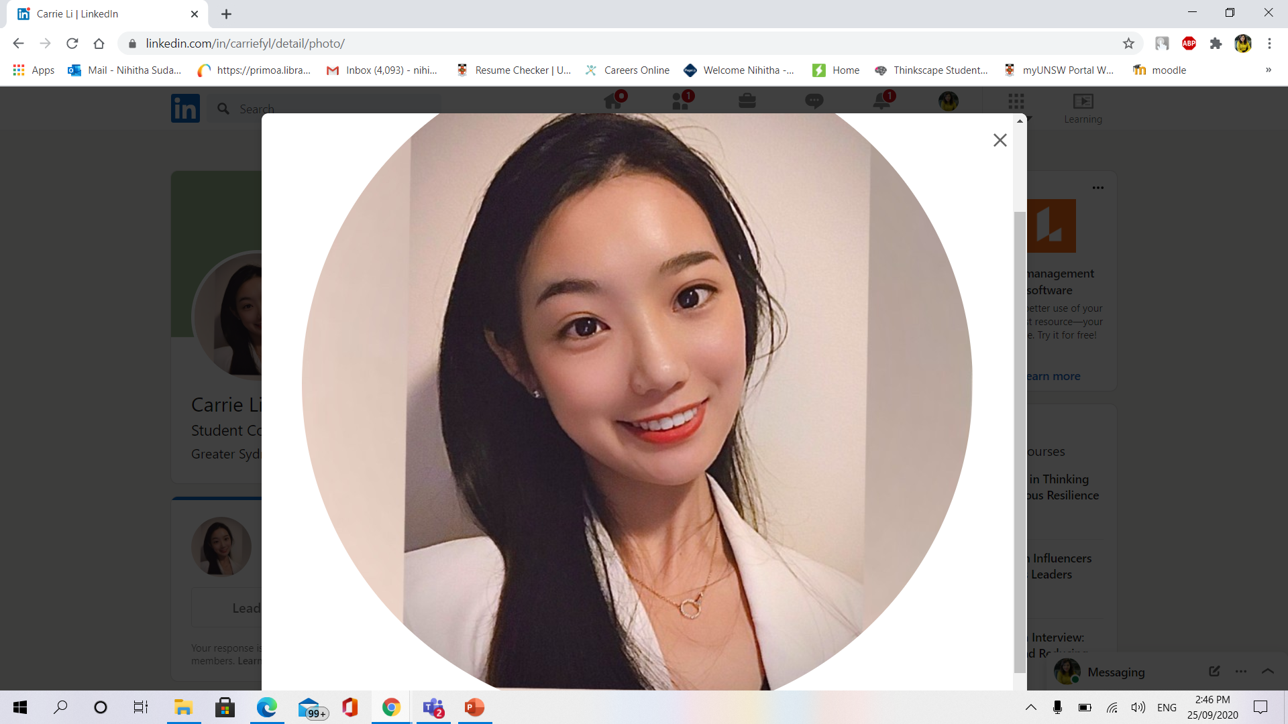
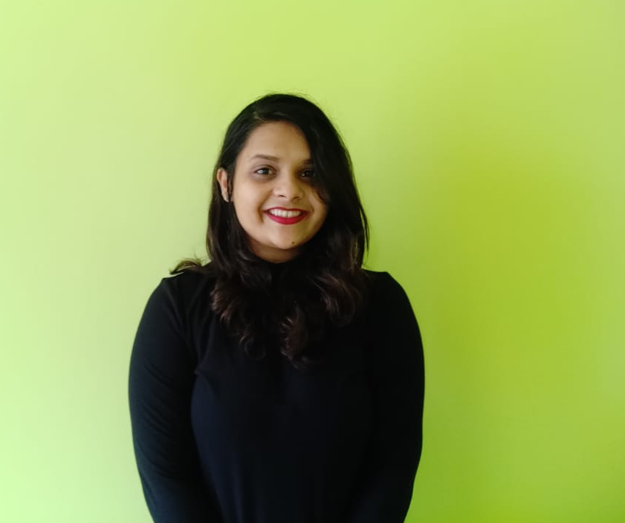
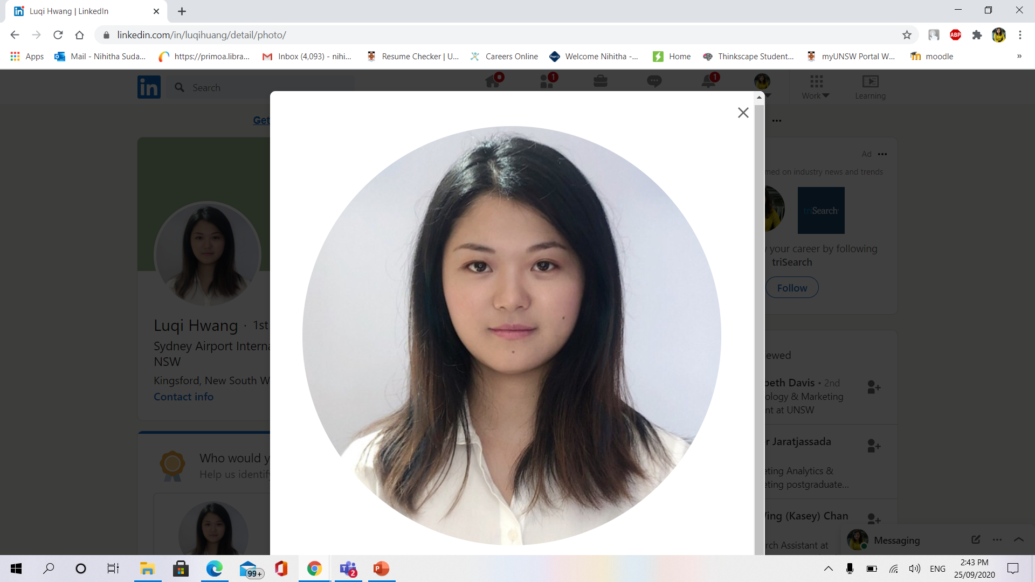
Meet the UNSW Heroes Team!
Coordinator & Web Designer:
Karan Inder Singh
Project Manager: Akshita Bhat
Mentor: Fengyang Li
Creative Head & Research: Nihitha Sudarsan
Web Designer & Prototype:
Luqi Hwang

